Slide 1
Learning to Generate Code Sketches
郭达雅
印鉴
Marc Brockschmidt
Alexey Svyatkovskiy
段楠
Miltiadis Allamanis

Slide 2
Introduction
Clarifying your intent to LMs is sometimes impossible or too costly.
LMs generate plausible but incorrect content.
Confusing or even misleading users, and producing bad user experience.
Grammformer generates sketches, i.e. code snippets with holes (■).
Context: import argparse ap = argparse.ArgumentParser() ap.add_argument("--release", action="store_true") ap.add_argument("--prerelease", action="store_true") | | Traditional left-to-right Transformer LM: ap.add_argument()
 | Grammformer (this paper): ap.add_argument(■, action="store_true")

Slide 3
Contributions
Grammformer, a Transformer-based grammar-guided code-generation model that generates code sketches.
Grammformer is allowed to expand the non-terminals in any order and stop generation whenever it wants to create ■s.
Grammformer is shown to be able to make longer and more precise statement-level sketch completions by evaluation on large corpora of Python and C# code.

Slide 4
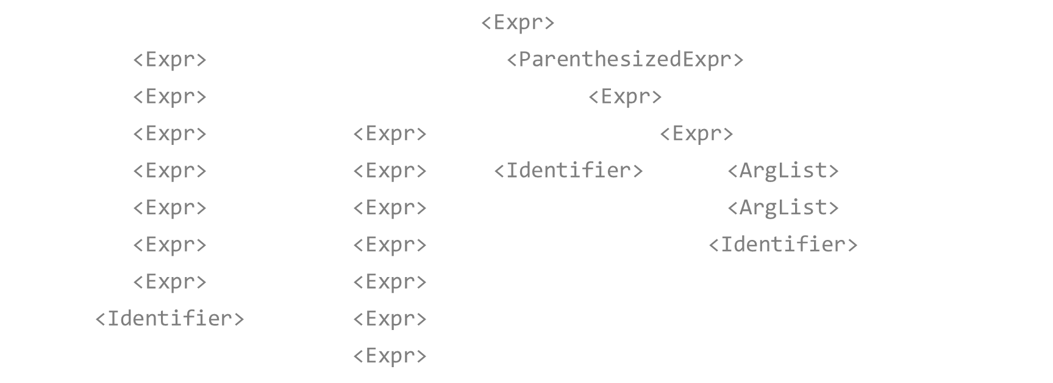
A case
Grammformer iteratively expands a non-terminal into a sequence until it chooses to stop; all non-terminals left are replaced with ■s.
r | = | <Expr> |  |  |  |  |  |  |  |  |  | $$i_{0}=3$$
r | = | <Expr> | * | <ParenthesizedExpr> |  |  |  |  |  |  |  | $$i_{1}=5$$
r | = | <Expr> | * | ( | <Expr> |  |  |  |  |  | ) | $$i_{2}=6$$
r | = | <Expr> | * | ( | <Expr> | - | <Expr> |  |  |  | ) | $$i_{3}=8$$
r | = | <Expr> | * | ( | <Expr> | - | <Identifier> | ( | <ArgList> | ) | ) | $$i_{4}=8$$
r | = | <Expr> | * | ( | <Expr> | - | foo | ( | <ArgList> | ) | ) | $$i_{5}=10$$
r | = | <Expr> | * | ( | <Expr> | - | foo | ( | <Identifier> | ) | ) | $$i_{6}=10$$
r | = | <Expr> | * | ( | <Expr> | - | foo | ( | args | ) | ) | $$i_{7}=6$$
r | = | <Identifier> | * | ( | <Expr> | - | foo | ( | args | ) | ) | $$i_{8}=6$$
r | = | x | * | ( | <Expr> | - | foo | ( | args | ) | ) | $$i_{9}=∅$$
r = x * (■ - foo(args))

Slide 5

Model
$P_{s}\left(i|x\right)$: select a non-terminal from $x$ to expand:
$$P_{s}\left(i | x\right)=\operatorname{softmax}\left(f(E{\left(x\right)}_{i})\right).$$
$f$ is a feed-forward neural network, $E$ is a Transformer encoder.
Generation ends when the token [CLS] is sampled from $P_{s}$.
$P_{e}\left(y|x,i\right)$: generate expansion sequence $y$ to replace $x_{i}$.
It is actually a relational Transformer decoder[1]:
$$Attention\left(Q,K,V\right)=softmax\left(\frac{1}{\sqrt{D_{k}}}Q{\left(W_{K}E\left(x\right)+\left[\overset{i−1}{\overbrace{0,…,0}},r_{h},0,…\right]\right)}^{T}\right)V.$$
$r_{h}$: trainable bias per head to denote $x_{i}$.

Slide 6

Loss
Self-critical policy gradient training[2][3]:
$$ℒ_{train}\left(x_{0}, x^{∗}\right)=\left(r\left(x_{out},x^{∗}\right)−\tilde{r}\left(x_{0}\right)\right)\left(\sum_{t=0}^{T}{−\log{P_{s}\left(i_{t}|x_{t}\right)}}+\sum_{t=0}^{T−1}{−\log{P_{e}\left({\hat{y}}_{t}|x_{t},i_{t}\right)}}\right).$$
$x_{0}$ is the initial sequence, $x^{∗}$ the ground-truth sequence of terminals.
$r\left(\hat{x},x^{∗}\right)$ is a reward function measuring the quality of a sketch $\hat{x}$ given a ground-truth $x^{∗}$.
$\tilde{r}\left(x_{0}\right)$ is the reward achieved by the prediction from the snapshots of $P_{s}$ and $P_{e}$ that achieved the best score so far.
The loss rewards improvement upon the previous best policy.

Slide 7

Pretraining
Motivation: directly optimizing $ℒ_{train}$ is computationally intensive.
Pretrain $P_{e}$ and $E$ with a uniform distribution on non-terminals:
$$ℒ_{pre−enc}\left(x_{t},{\left\{y_{t⊚i}^{∗}\right\}}_{i∈N\left(x_{t}\right)}\right)=𝔼_{i\sim 𝒰\left(N\left(x_{t}\right)\right)}\left[−\log{P_{e}\left(y_{t⊚i}^{∗}|x_{t},i\right)}\right].$$
Note that it is supervised.
Optimize $P_{s}$ with frozen $E$ using $ℒ_{train}$.
Only parameters of $f$ is trained in this step.
Fine-tune the whole model end-to-end using $ℒ_{train}$.

Slide 8

Metrics
New and first metric for sketch generation: RegexAcc:
$$RegexAcc\left(\hat{s}, s^{∗}\right)≔\frac{\left|\hat{s}\right|}{\left|s^{∗}\right|}𝕀\left[toRegex\left(\hat{s}\right) matches s^{∗}\right].$$
Regex match: ensure sketches can be completed into the correct output.
$\left|\hat{s}\right|$: reward precise sketches.
Rouge since sketches can be thought as a form of summary.
More lenient to errors and non-matching but plausible sketches.
Average length of the output.
Metrics is only reported over the generated part of the sequence.

Slide 9

Datasets
All non-fork repositories with at least 20 stars from GitHub using Python or C# as top language.
Deduplicate the corpus using methods of [4][5].
Parse all files into syntax trees with Tree-sitter.
Ignore unparsable files.
Split the files into 70-10-20 train-validation-test.
Use <SimpleStatement>s as examples.
Use 200 terminal tokens before it as context.
 |  | Python | C#
Number of Files/Trees | Training | 1973400 | 1948516
 | Validation | 218398 | 216299
 | Test | 460874 | 480166
Number of tokens of $x_{t}$ | Average | 194.5 | 201.4
 | Median | 205 | 106
 | 99% | 250 | 260
Number of tokens of $y$ | Average | 1.9 | 1.9
 | Median | 1 | 1
 | 99% | 9 | 7

Slide 10
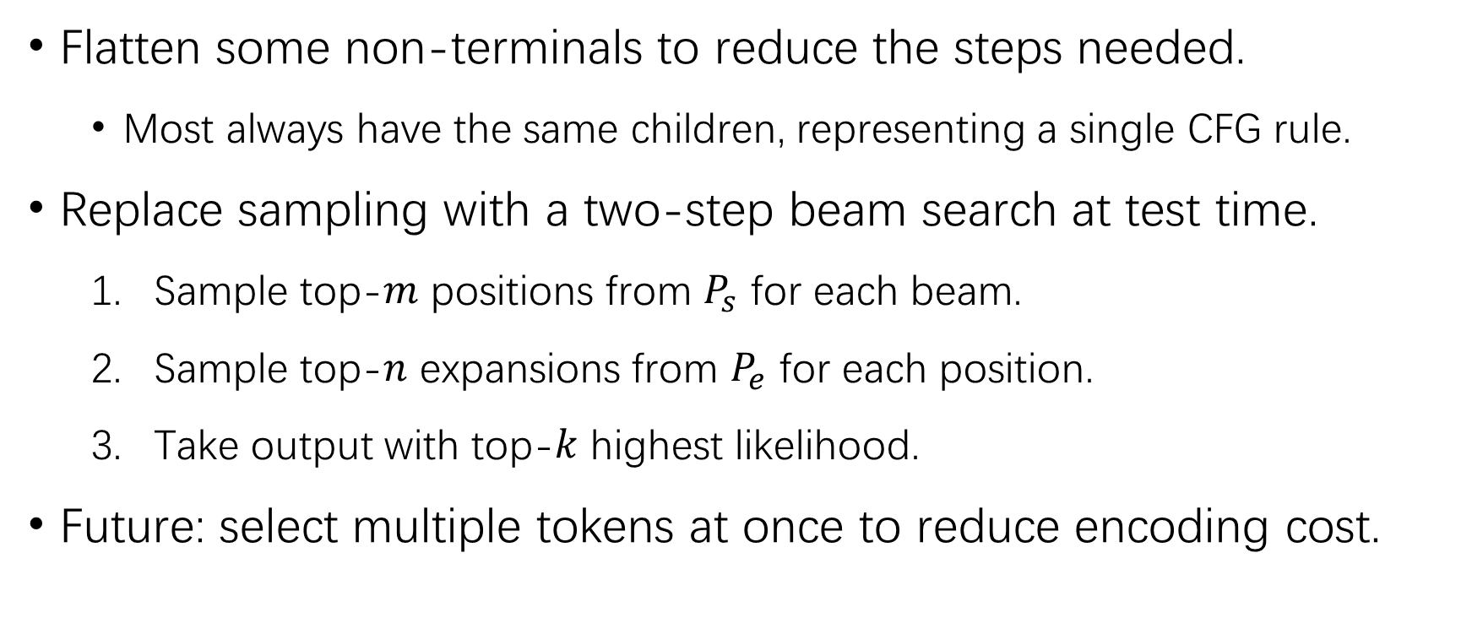
Practical Considerations
Flatten some non-terminals to reduce the steps needed.
Most always have the same children, representing a single CFG rule.
Replace sampling with a two-step beam search at test time.
Sample top-$m$ positions from $P_{s}$ for each beam.
Sample top-$n$ expansions from $P_{e}$ for each position.
Take output with top-$k$ highest likelihood.
Future: select multiple tokens at once to reduce encoding cost.

Slide 11

Training Details
6-layer 12-head 768-dim Transformers.
25000 vocabulary size with BPE.
Input length and output length: 512 and 64.
Adam optimizer with 4096 batch size and 2e-5 learning rate.
64 P100 with 16G memory for 10 days.
One random <SimpleStatement> per file to evaluate at test time.
$k=5, m=∞,n=1.$
$$r\left(\hat{x},x^{∗}\right)=\frac{1}{2}\left(RegexAcc\left(\hat{s}, s^{∗}\right)+{Rouge}_{F1}\left(EraseHoles\left(\hat{s}\right), s^{∗}\right)\right).$$

Slide 12

Baselines
$L→R$: a standard token-level language model.
This model cannot generate ■s.
$L→R+∅$: $L→R$ but can stop generation to create a ■.
The ■s this model creates are always at last.
Learns to maximize reward function $r$ with $ℒ_{train}$.
Essentially a token-level language model with a learnable stop ability.
Same architectures to Grammformer without $r_{h}$.
$L→R$ additionally does not have $P_{s}$.

Slide 13

Results & Ablation Study
 | C# |  |  |  |  | Python
 | RegexAcc |  | Rouge | Average Length |  | RegexAcc |  | Rouge | Average Length
 | Top-1 | Top-5 |  |  |  | Top-1 | Top-5
$L→R$. | 0.42 | 0.47 | 77.0 | 7.1 |  | 0.17 | 0.20 | 53.2 | 5.8
$L→R+∅$. | 0.45 | 0.54 | 69.1 | 5.3 |  | 0.20 | 0.29 | 39.3 | 3.0
Grammformer | 0.47 | 0.59 | 77.4 | 7.5 |  | 0.21 | 0.30 | 51.6 | 6.1
Pretraining only. | 0.45 | 0.57 | 77.0 | 7.2 |  | 0.20 | 0.29 | 50.2 | 5.7
$P_{s}=𝒰$; no $∅$. | 0.42 | 0.54 | 78.3 | 8.1 |  | - | - | - | -
$P_{s}=𝒰$; stop when $P\left(x_{t}\right)<p$. | 0.45 | 0.57 | 71.6 | 5.8 |  | - | - | - | -
$r\left(∙\right)={Rouge}_{F1}$. | 0.42 | 0.54 | 78.2 | 8.1 |  | - | - | - | -
$r\left(∙\right)=RegexAcc$. | 0.51 | 0.62 | 70.8 | 5.8 |  | - | - | - | -

Slide 14
C# Sketch Length

Slide 15
Python Sketch Length

Slide 16
C# Accuracy

Slide 17
Python Accuracy

Slide 18
Conclusion
Grammformer, a generative model of code that can generate sketches.
Discussions
Larger Transformer?
Human studies for sketch generation metrics?
Modeling natural language?
Utilize more code-specific semantics?

